Slide 1
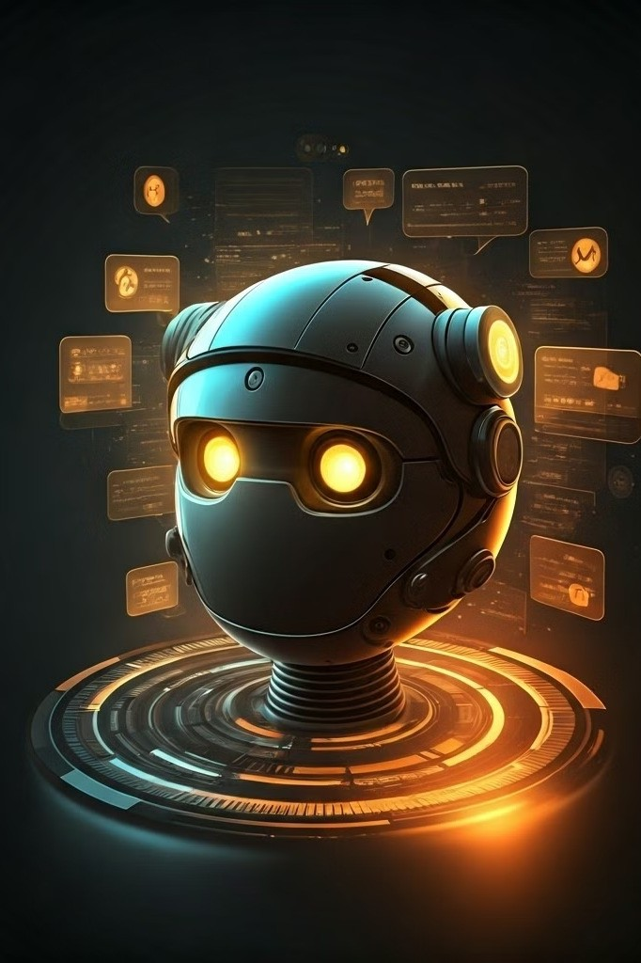
ARTIFICIAL INTELLIGENCE CHATBOT SYSTEM
Group Member’s
Dushyant Rajput Admission No.=23SCSE1010647
Astha Dasila Admission No.=23SCSE1011092
Radha Mishra Admission No.=23SCSE1012214
Utkarsh Yadav Admission No.=23SCSE1012431

Slide 2
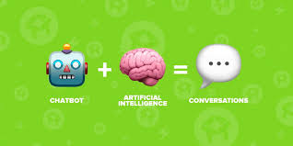
INTRODUCTION
Artificial intelligence (AI) chatbots are conversational agents powered by advanced natural language processing and machine learning algorithms. They enable seamless human-computer interaction, providing personalized assistance and enriching customer experiences.

Slide 3
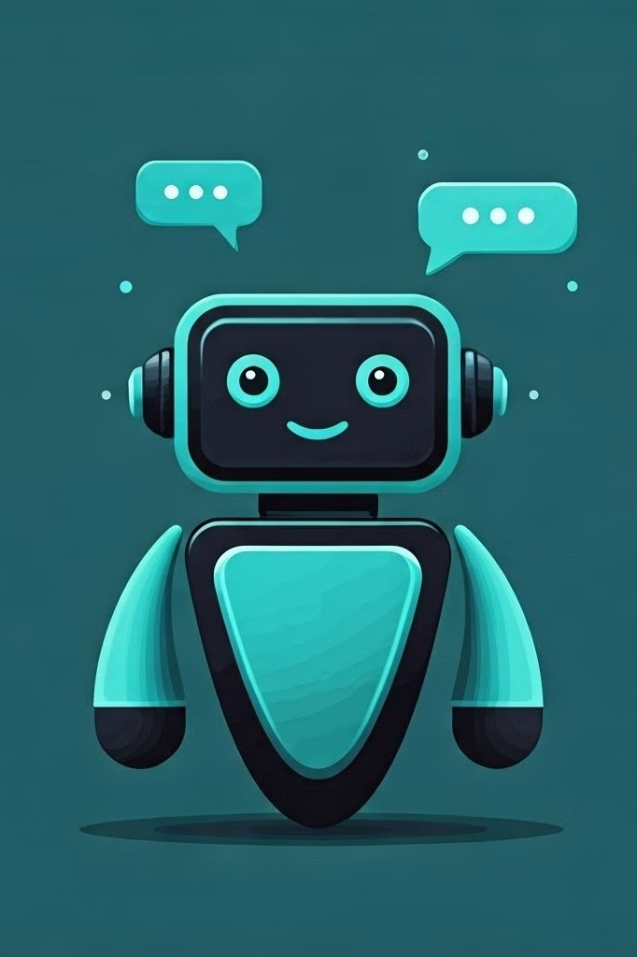
What is an AI Chatbot?
1
Intelligent Conversation
AI chatbots can understand and respond to natural language, engaging in human- like dialogue.
2
Automated Assistance
They can handle a wide range of tasks, from customer service to information retrieval, without human intervention.
3
Personalized Experience
AI chatbots can adapt their responses based on user preferences and behaviors, creating a tailored experience.

Slide 4
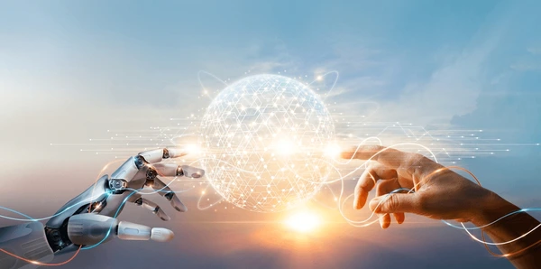
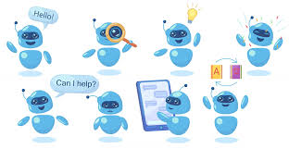
Benefits of AI Chatbots
Improved Efficiency
AI chatbots can handle multiple conversations simultaneously, streamlining customer interactions and improving response times.
Cost Savings
Chatbots can reduce the need for human customer service agents, leading to significant cost savings for businesses.
24/7 Availability
AI chatbots are available around the clock, providing instant assistance to users regardless of time or location.

Slide 5
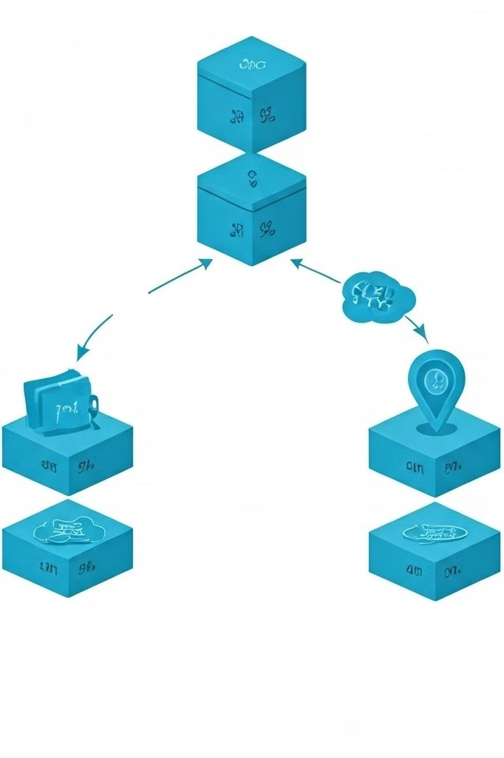
Key Components of an AI Chatbot System
1
Natural Language Processing
Understand user inputs and convert them into structured data for processing.
2
Dialogue Management
Interpret user intent, determine appropriate responses, and manage the conversation flow.
3
Backend Integration
Connect the chatbot with external data sources and systems to provide relevant information and functionality.

Slide 6

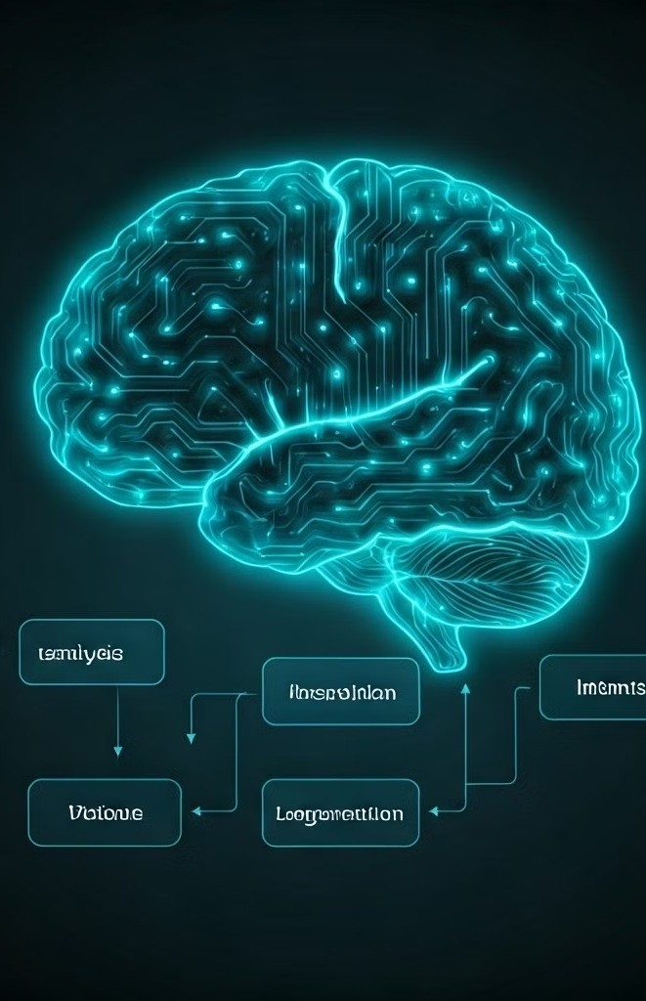
Natural Language Processing (NLP) in Chatbots
Intent Recognition
Advanced NLP models can identify the user's underlying intent, allowing the chatbot to provide a more contextual response.
Text Analysis
NLP techniques like tokenization, part-of-speech tagging, and named entity recognition help the chatbot understand the user's input.
Language Generation
NLP-powered language generation enables the chatbot to produce human-like, coherent responses that address the user's needs.
Multilingual Support
NLP can enable chatbots to understand and converse in multiple languages, expanding their reach and accessibility.

Slide 7




Machine Learning and AI Chatbot Training
Data Collection
Gather a diverse set of conversational data to train the chatbot's language understanding and generation capabilities.
Model Training
Apply advanced machine learning algorithms to the training data, enabling the chatbot to learn and improve its responses.
Evaluation and Refinement
Continuously test the chatbot's performance and refine the model to ensure high accuracy and user satisfaction.
Deployment
Integrate the trained chatbot into the target platform or application to provide intelligent, conversational assistance.

Slide 8

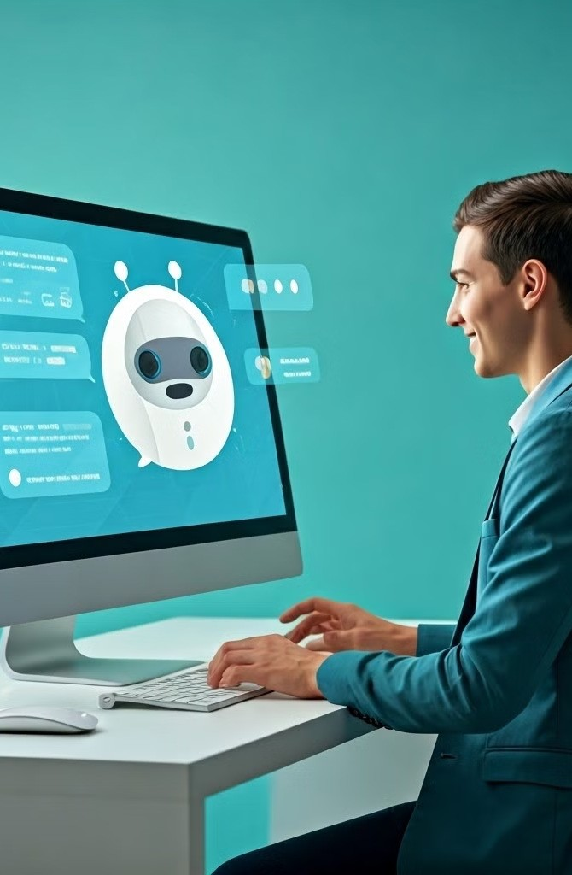
Designing an Engaging Chatbot User Experience
Conversational Interface
1
Develop a natural, human-like dialogue flow that makes the user feel comfortable and understood.
Personalization
Tailor the chatbot's personality, language, and responses to match the user's preferences and needs.
2
Multimodal Interactions
Incorporate visual elements, such as images and buttons, to enhance the user experience and provide additional functionality.
3

Slide 9

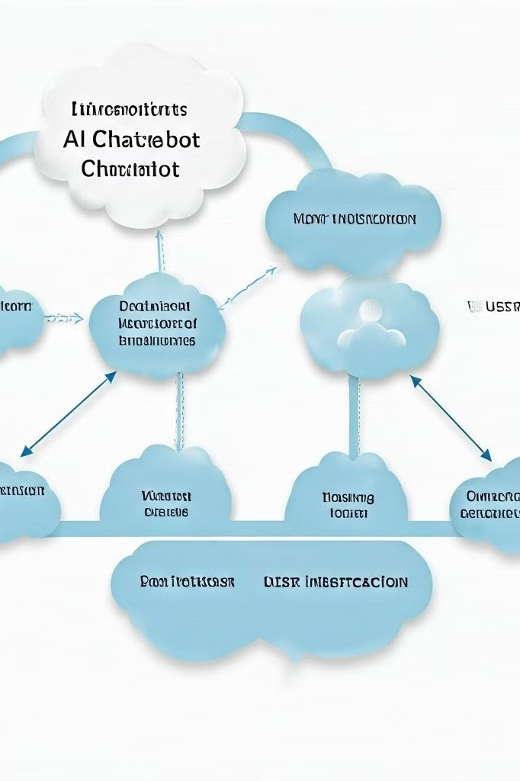
Implementing and Deploying an AI Chatbot
Platform Integration
Seamlessly integrate the chatbot with the target platform, such as a website, mobile app, or messaging channel.
Backend Connectivity
Connect the chatbot to relevant data sources and enterprise systems to provide comprehensive information and functionality.
Testing and Monitoring
Rigorously test the chatbot's performance, monitor user interactions, and continuously optimize the system.

Slide 10

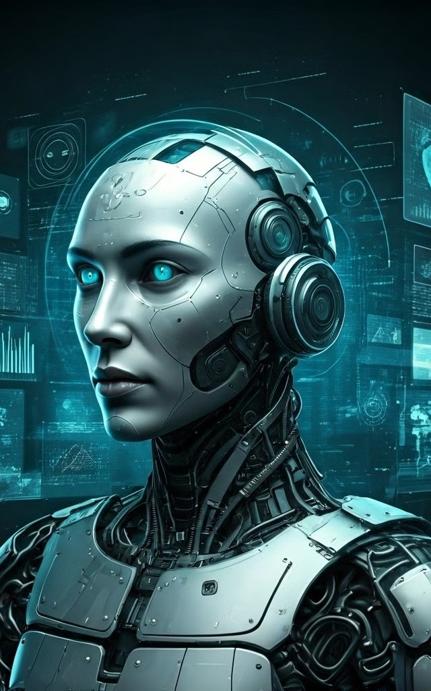
Future Trends in AI Chatbot Technology
1
Multimodal Interactions
Chatbots that can engage users through voice, gesture, and other modalities, creating a more natural and intuitive experience.
2
Contextual Awareness
Chatbots that can understand the user's environment, preferences, and historical interactions to provide highly personalized and relevant responses.
3
Emotional Intelligence
Chatbots that can recognize and respond to human emotions, fostering deeper connections and more empathetic interactions.
4
Autonomous Decision- Making
Chatbots that can independently make decisions and take actions based on their understanding of the user's needs and the broader context.

Slide 11
THANKYOU

